Slide 1

ARTIFICIAL INTELLIGENCE
&
MACHINE LEARNING
SESSION NO : 17
Probability & Statistics
(Bayes’ theorem and ML relevance)

Slide 2
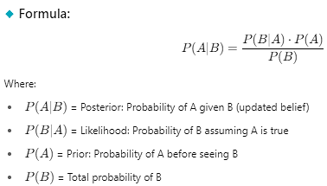
Bayes’ Theorem
Bayes’ Theorem helps us update the probability of a hypothesis based on new evidence.
It connects: Prior Probability (What we believed before)
Likelihood (How likely the evidence is)
Posterior Probability (What we believe after seeing the evidence)

Slide 3
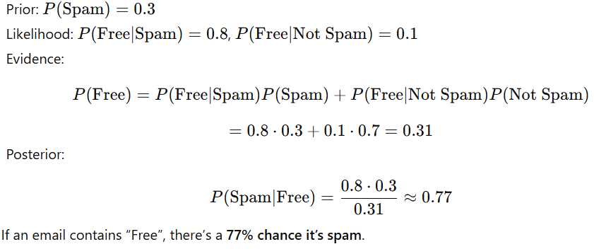
Bayes’ Theorem
Example (Spam Filter using Bayes)
Suppose we want to detect if an email is spam based on the word “Free”.

Slide 4
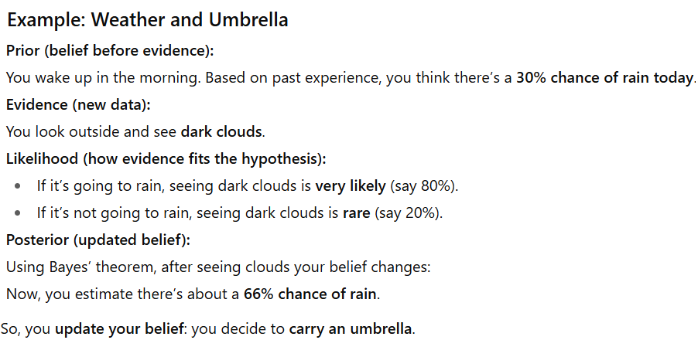
Bayes’ Theorem

Slide 5
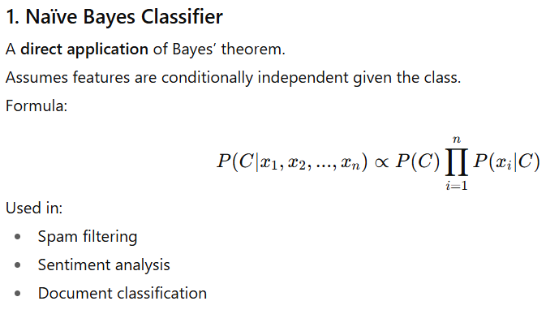
Machine Learning Relevance of Bayes’ Theorem
Bayes’ theorem is fundamental in ML because it provides a mathematical framework for reasoning under uncertainty.

Slide 6
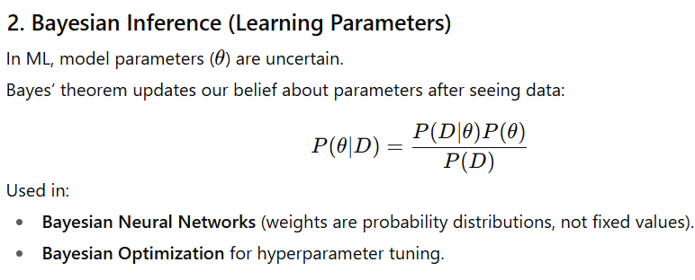
Machine Learning Relevance of Bayes’ Theorem

Slide 7
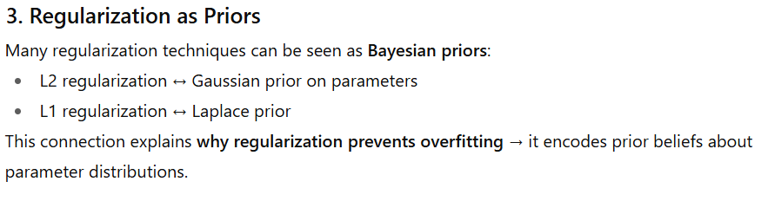
Machine Learning Relevance of Bayes’ Theorem

Slide 8
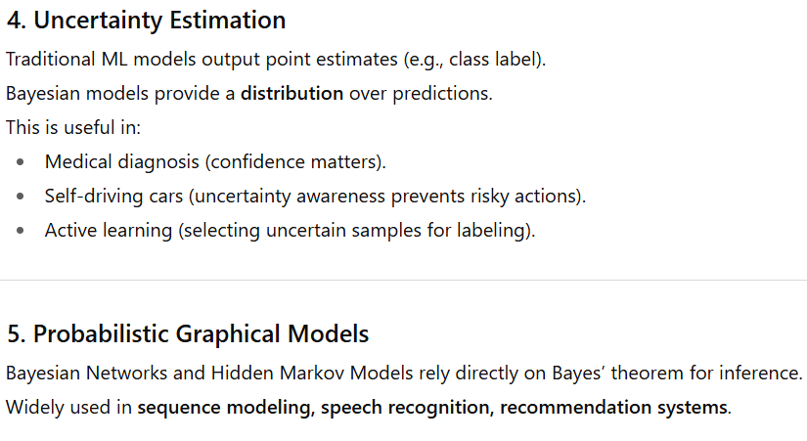
Machine Learning Relevance of Bayes’ Theorem

Slide 9
Machine Learning Relevance of Bayes’ Theorem
Bayes’ theorem in ML is important because :
Enables probabilistic classification (Naïve Bayes).
Supports parameter learning and inference.
Justifies regularization as prior knowledge.
Provides uncertainty estimation for safe and interpretable AI.
Powers graphical models for structured prediction.

Slide 10
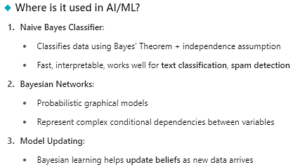

Slide 11

THANK YOU

